Slide 1
Access Control Systems & Methodology
Lecture 3 (continued)
Lec Asad Raza

Slide 2
Overview
Identification
Authentication
Authorization
Access Controls Models
Single Sign-On Technologies
Threats and Attacks on Different Technologies

Slide 3
Access Control Administration
Some different ways to administer access control are centrally, decentralized or a hybrid of two.

Slide 4
Centralized Access Control
Using many technologies, a group within the company is responsible for implementing access controls.
RADIUS, TACACS+ and Diameter are technologies that can enforce centralized access control.
RADIUS, TACACS+ and Diameter are AAA protocols.
  AAA protocols provide authentication, authorization and auditing functionality.

Slide 5
RADIUS (Remote Authentication Dial-in User Service)
RADIUS is an open Internet de facto standard used for remote user authentication.
RADIUS works on a client-server model.
The RADIUS client is the access server that communicates to a backend RADIUS server.
RADIUS is commonly used for Internet access and corporate network access.

Slide 6
TACACS+ (Terminal Access Controller Access-Control System Plus)
TACACS used fixed password
TACACS+ uses one time passwords
TACACS+ is a similar authentication protocol but is proprietary and owned by CISCO.
TACACS+ works on a client-server model.
TACACS+ breaks up authentication, authorization and auditing into single features that can be enabled or disabled.

Slide 7
RADIUS Vs. TACACS+
RADIUS uses the UDP transport protocol. TACACS+ uses TCP.
RADIUS only encrypts the user’s password and TACACS+ encrypts all user authentication data.
TACACS+ splits up the AAA but RADIUS provides them as one module.

Slide 8
Diameter
Diameter is a new authentication protocol that builds upon RADIUS.
Diameter allows devices to use many authentication techniques.
RADIUS is restricted to work over SLIP and PPP connections. Diameter does not have this restriction.
Diameter works in a peer-to-peer model.

Slide 9
Decentralized Access Control
Not one group enforcing access rules.
Changes can happen faster
Different Managers and Departments can practice security
Peer-to-peer model is an example.

Slide 10
Hybrid Access Control
Most environments work in a hybrid model, combining centralized and decentralized access controls.

Slide 11
Technical Access Control
There are several techniques that are used to control subjects’ activities in an environment.
  System Access
  Network Architecture
  Network Access
  Auditing
  Encryption

Slide 12
System Access
Access control in an individual system.
Different types of controls and security mechanisms control how a computer is accessed
These technical controls may be
  Username and password
  Kerberos , Biometrics , PKI etc

Slide 13
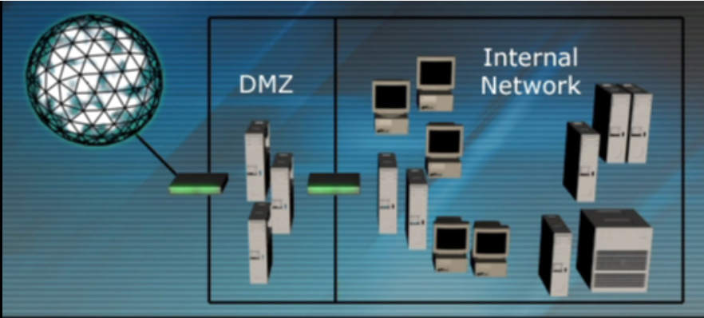
Network Architecture
Companies need to understand the flow of the traffic through their network and properly control it.

Slide 14
Access Control Characteristics
Access control can provide different services.
Preventative
  Controls to avoid undesirable events
Detective
  Controls to identify undesirable events that have occurred.
Corrective
  Controls to correct undesirable events that have occurred.

Slide 15
Access Control Characteristics
Deterrent
  Controls to discourage security violations.
Recovery
  Controls to restore resources and capabilities.
Compensation
  Controls to provide alternatives to other controls.

Slide 16
Detective Controls: Log Protection
Hackers usually try to manipulate security logs to hide their tracks.
Log permissions should be strict, run through a hashing tool and stored on write-once media.
Some companies are regulated by laws stating how long logs should be kept and level of protection required.

Slide 17
Unauthorized Disclosure of Information
Data can be disclosed intentionally or unintentionally and companies should protect against both types of threats.
Few ways information can be disclosed:
  Social Engineering
  Object Reuse
  Keyboard Monitoring
  Electrical Signals

Slide 18
Social Engineering
Attack that convinces someone that an imposter is authorized to access resources.
Email spoofing is an example of social engineering that is very easy to accomplish.

Slide 19
Object Reuse
Sensitive data must be properly erased from media before a second subject uses it.
Deleting files only deletes the pointers to those files, not the files themselves.
Formatting a drive erases all pointers in the file allocation table. The files still reside on the drive.
To enforce proper reuse degaussing, zeroization or physical destruction can be used.

Slide 20
Keystroke Monitoring
Keystroke monitoring collects all the keystrokes a person types in.

Slide 21
Emanation Security
Electrical devices give off radiation. Sensitive data can be gathered from these electrical signals.
Sophisticated software and hardware gathers electrical signals and recompiles them into their original forms.
TEMPEST, control zones and white noise can be used to thwart emanation attacks.

Slide 22
TEMPEST
TEMPEST started as a U.S. government study of how data can be captured through emanation.
TEMPEST was then turned into a standard that the vendors had to meet.
Faraday Cage: Metal material around a device to reduce released radiation to an acceptable level.
Today the word TEMPEST is not used as often. This branch of security is now called Emission Security (EMSEC).

Slide 23
Alternatives of TEMPEST
CONTROL ZONES
  Ceilings and walls are re-enforced with material that hinders electrical signals from leaving an area.
WHITE NOISE
  White noise uses a device to send out jamming signals that will combine with data signals.

Slide 24
Questions ?

